Slide 1
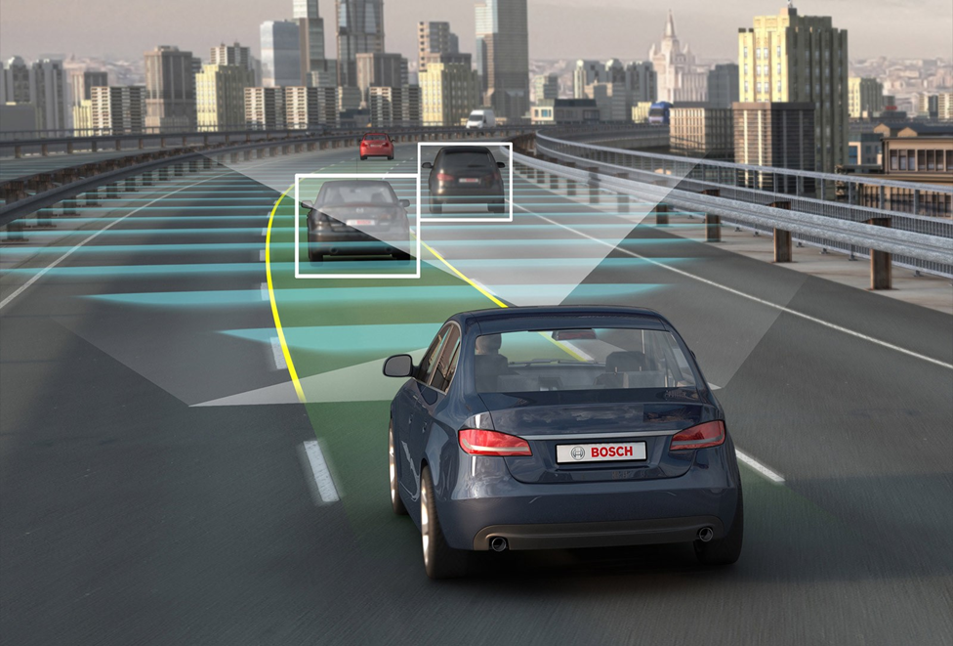
Relative velocity for autonomous vehicles
Jonathan pilling
ECE 3030
Notes:
General Background, the scope of the problem, and overview of solutions.

Slide 2
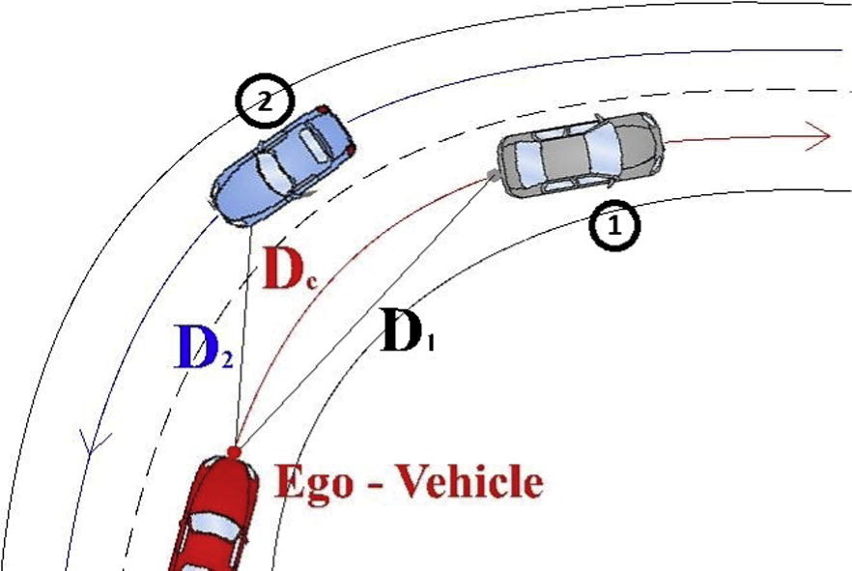
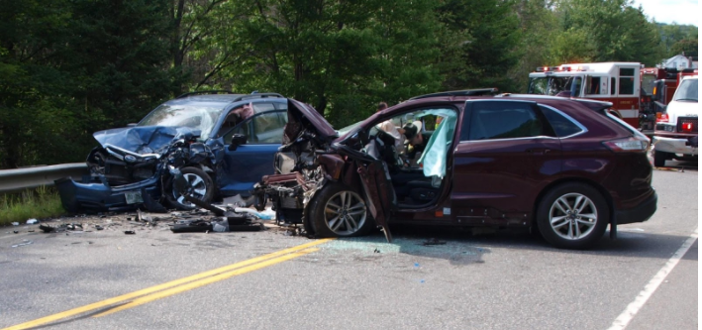
Autonomous vehicles that calculate relative velocity are safer
Notes:
General Background, the scope of the problem, and overview of solutions.

Slide 3
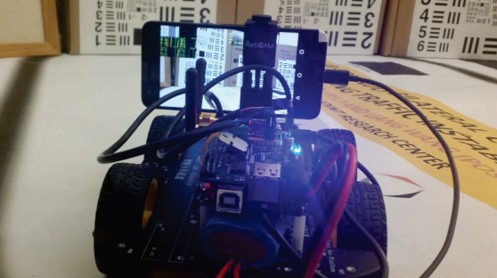
Time to contact is the ratio of depth/speed in camera space
Estimates relative velocity by using inverse of TTC multiplied by distance.

Slide 4
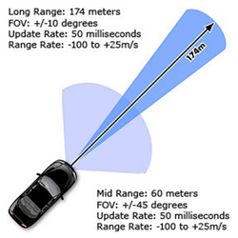
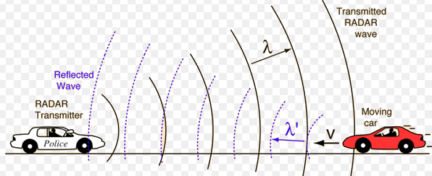
Delphi ESR Radar used to calculate distance and speed
Uses radio frequencies to detect objects.

Slide 5


In summary
TTC suffers when the camera vibrates, smears images.
Speed calculation from radar is dependent on reflected waves.
Combining sensors to make the safest autonomous vehicle.

Slide 6
References
[1] R. R. Ojha, autonomous-cars. 2017.
[2] C. Katrakazas, M. Quddus, W.-H. Chen, and L. Deka, “Real-time motion planning methods for autonomous on-road driving: State-of-the-art and future research directions,” Transportation Research Part C: Emerging Technologies, vol. 60, pp. 416–442, 2015.+
[3] K. Landrigan, New Hampshire Union Leader. 2018.
[4] L. Wang and B. K. P. Horn, "Time-to-Contact control for safety and reliability of self-driving cars," 2017 International Smart Cities Conference (ISC2), Wuxi, 2017, pp. 1-4.
[5] AutonomouStuff. 2018.
[6] HyperPhysics.

